Slide 2
Thank you Keptn Obvious!
Making observability actionable with Prometheus and Keptn
Andreas Grabner
Dynatrace / Keptn
May 2022
Notes:
https://tanzu.vmware.com/content/blog/role-of-security-in-the-developer-experience

Slide 3

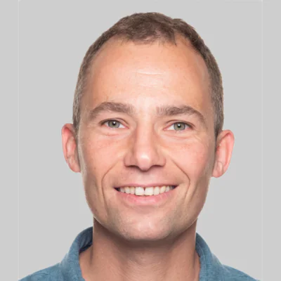
ATTENTION DEVELOPERS
Andreas Grabner
DevOps Activist, Dynatrace
Keptn maintainer & co-founder
THIS IS YOUR KEPTN
SPEAKING

Slide 4

ONE DOES NOT SIMPLY DO
SRE

Slide 5
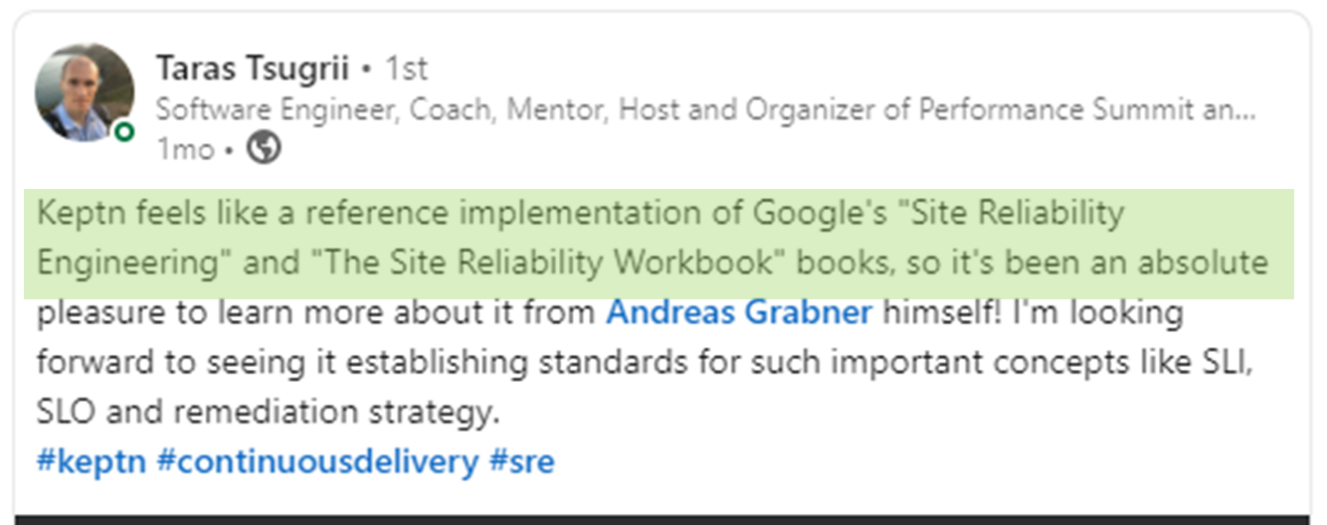
But Keptn actually makes it simple!

Slide 6

















Modern cloud native systems are no longer simple!
CI/CD
Production
Staging

Slide 7

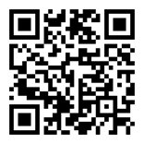
Observability is a must

Slide 8
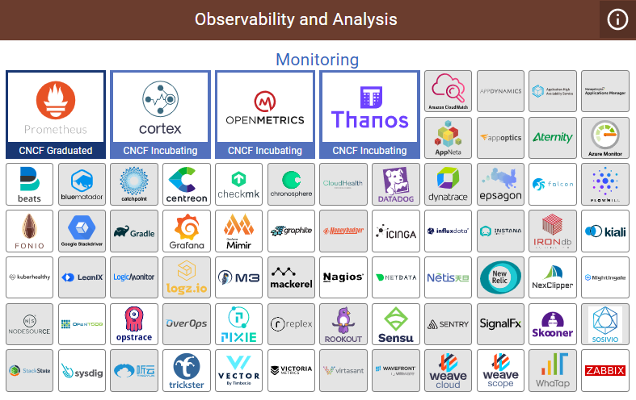
https://landscape.cncf.io/

Slide 9
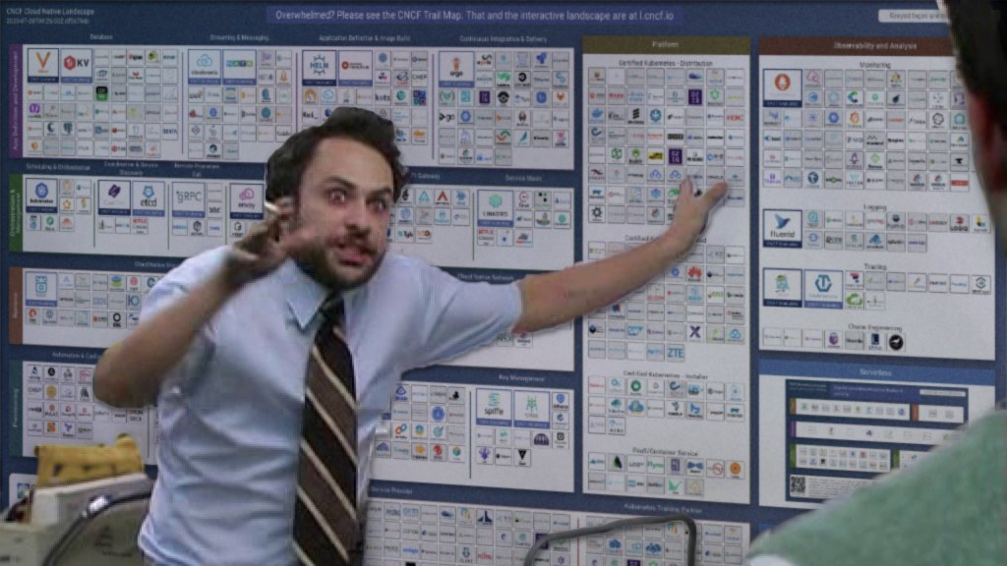
https://twitter.com/dastbe/status/1303858170155081728

Slide 10












Open Observability is here to help …

Slide 11



Slide 12

Have data?
Act/orchestrate on it!

Slide 13
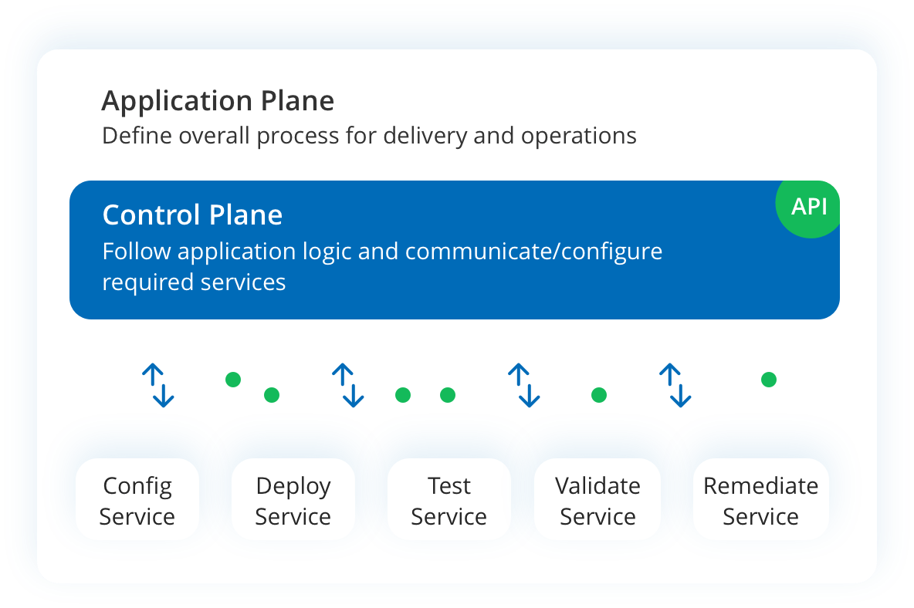
Keptn in other words …
Observability-driven orchestration for your cloud native apps
https://keptn.sh

Slide 14

ONE PLATFORM
TO ORCHESTRATE THEM ALL

Slide 15

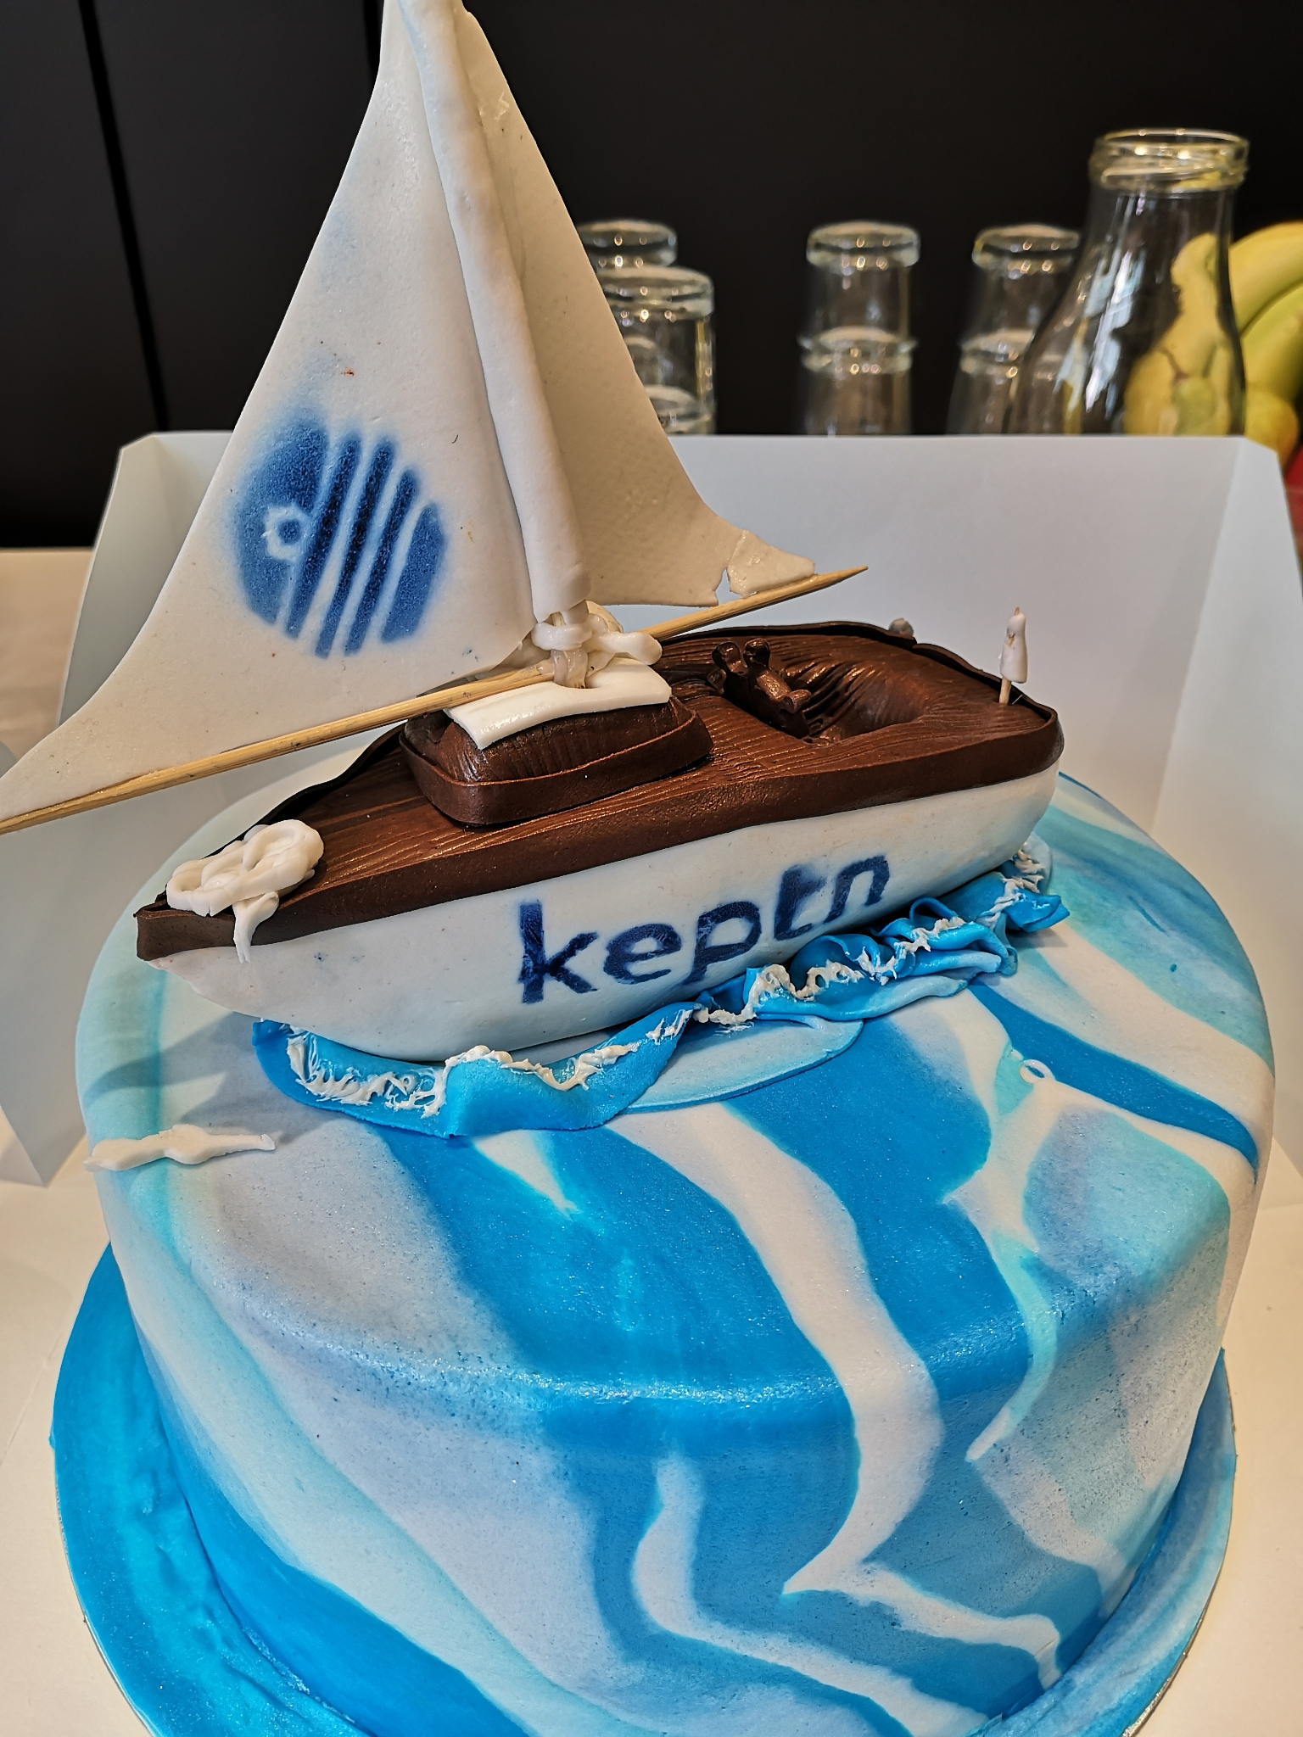
Keptn
CNCF Sandbox project
Control plane, admin frontend/CLI
Observability, dashboards & alerting
SLO-driven multistage delivery
Operations & remediation
https://keptn.sh

Slide 16
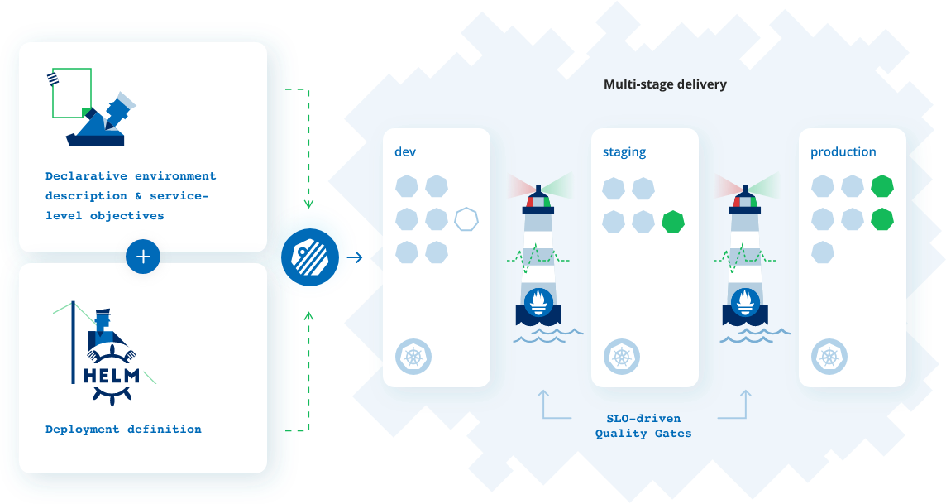
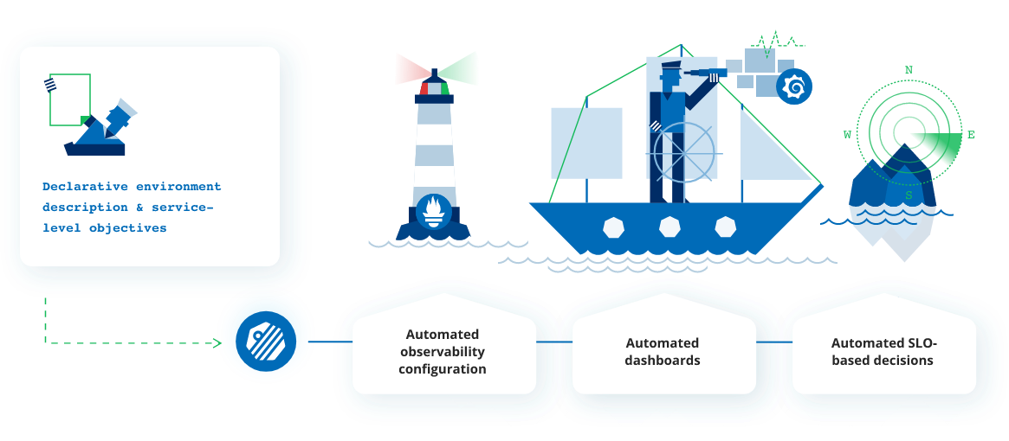

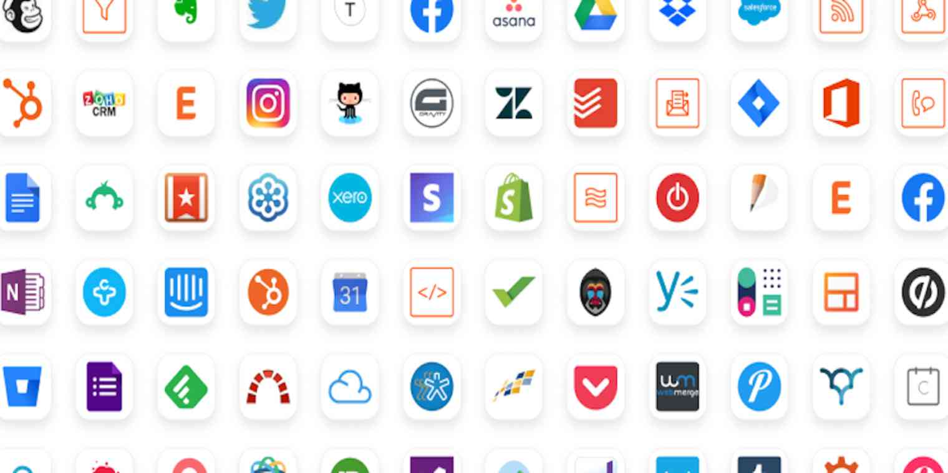
Auto-remediation
Notifications
SLO Evaluation &
Monitoring
Metrics / SLI Providers
4,000+ apps

Slide 17

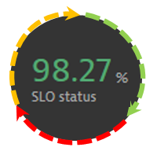
Automated Data-Driven Orchestration of all your tools
Control Plane
CloudEvents

Slide 18









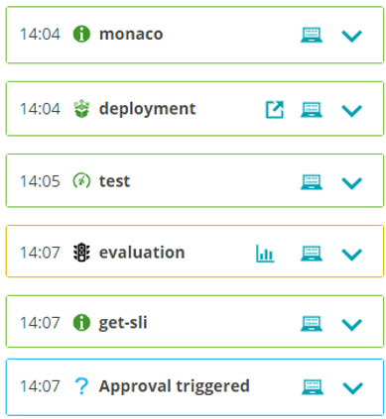
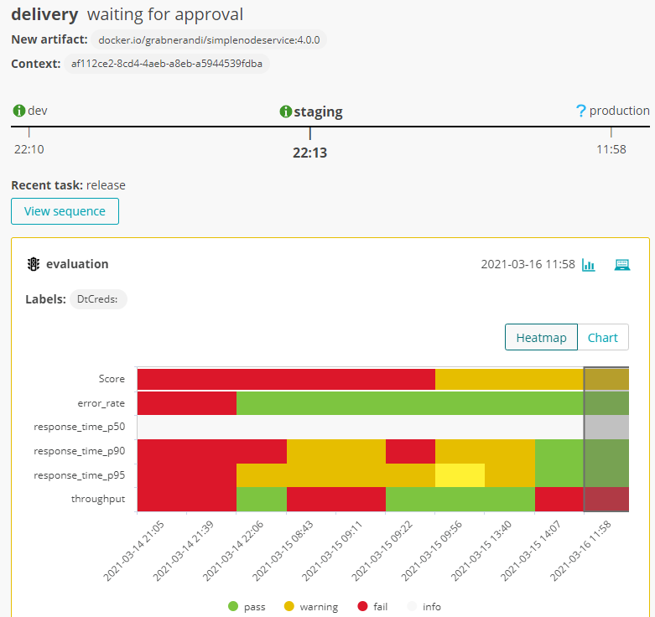










SLOs (queried from Observability) are in the core of Keptn
Orchestration sequences
Orchestration, monitoring , deployment, test , evaluation of SLOs

Slide 19

Keptn and Prometheus
Your App
SLO Evaluation &
Monitoring
Prometheus Integration Service
Auto-remediation loop

Slide 20

Keptn integrates with other tools
CLI / REST API

Slide 21
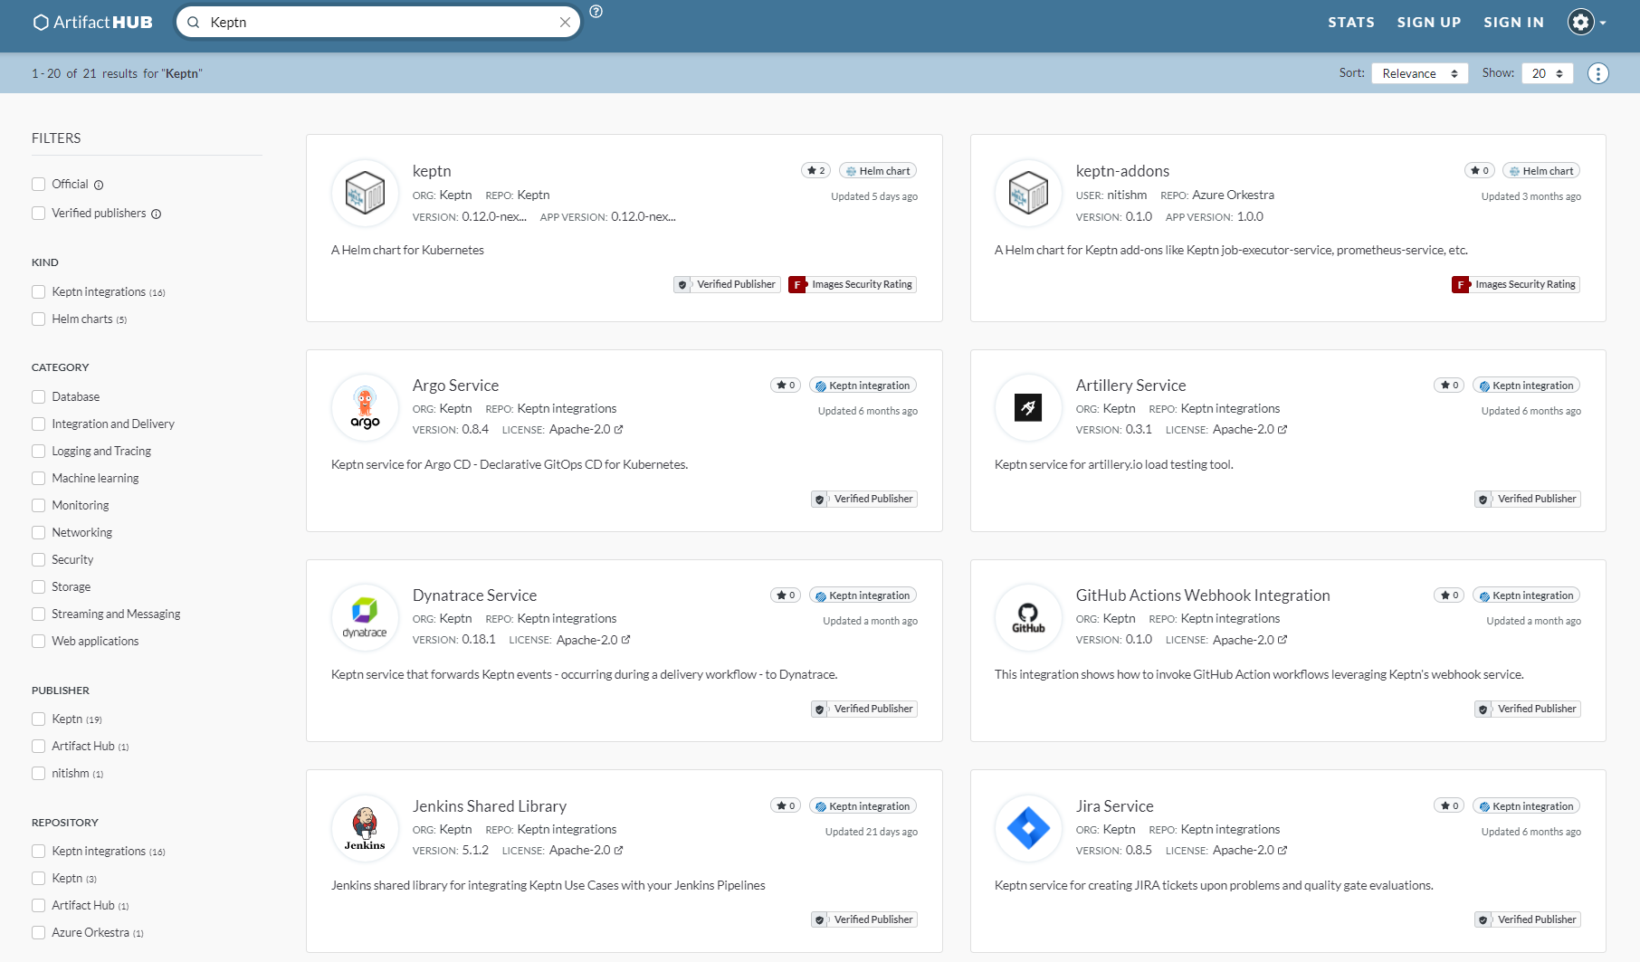
Keptn is extensible
https://artifacthub.io/packages/search?ts_query_web=Keptn
Notes:
Integrations!

Slide 22
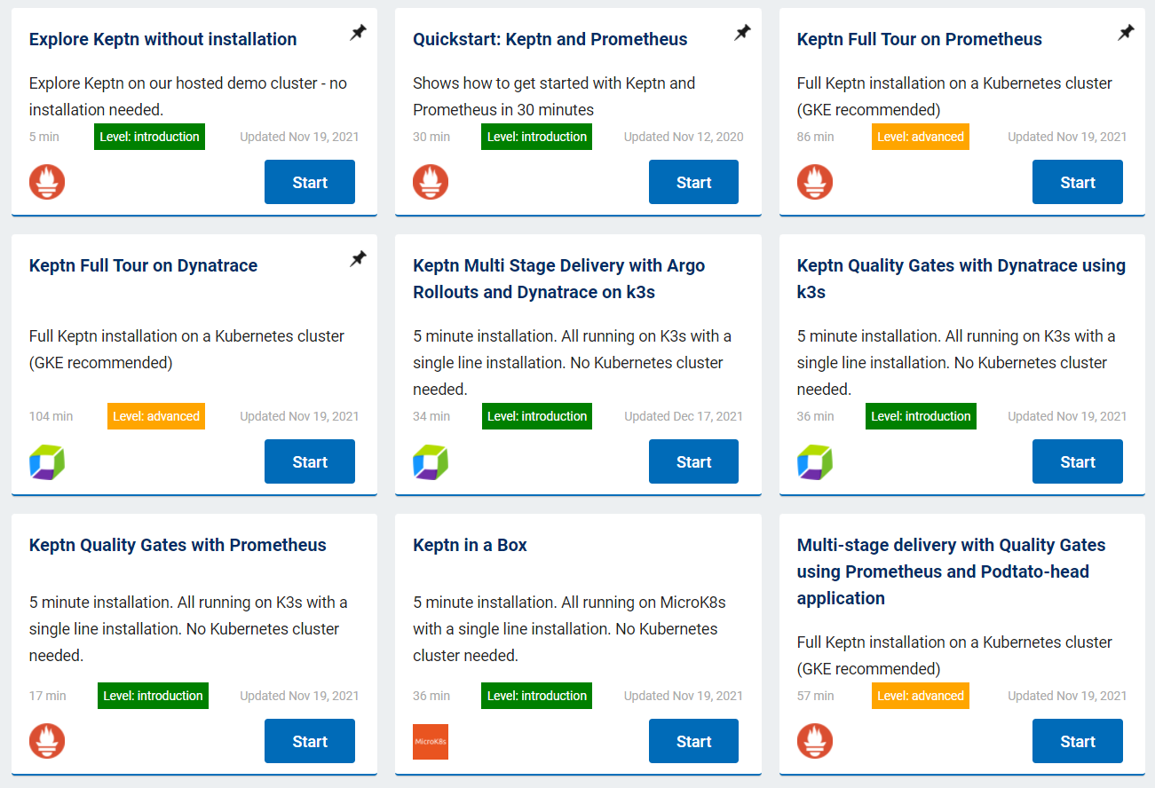
Come aboard!
keptn.sh/docs/quickstart
Quickstart (K3D, K8s)
Tutorials:
Prometheus
Dynatrace
ArgoCD
Jenkins
Soon: Datadog

Slide 23
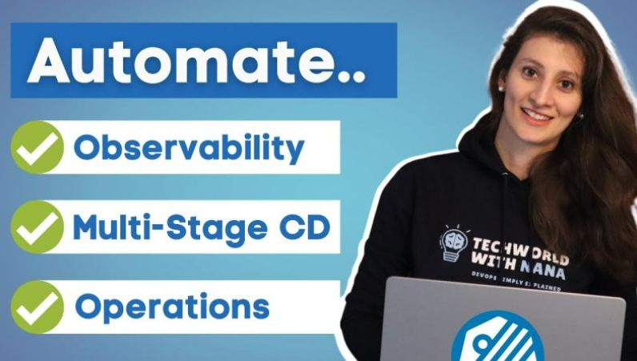
More about Keptn
Techworld with Nana,
March 2022
https://www.youtube.com/watch?v=3EEZmSwMXp8

Slide 24


Learn more at Kubecon
Hallway track: Meet Keptn crew!
Keptn Kiosk at the projects pavilion
Project office hours on May 19
#event-kubecon, keptn.sh/community/#slack

Slide 25
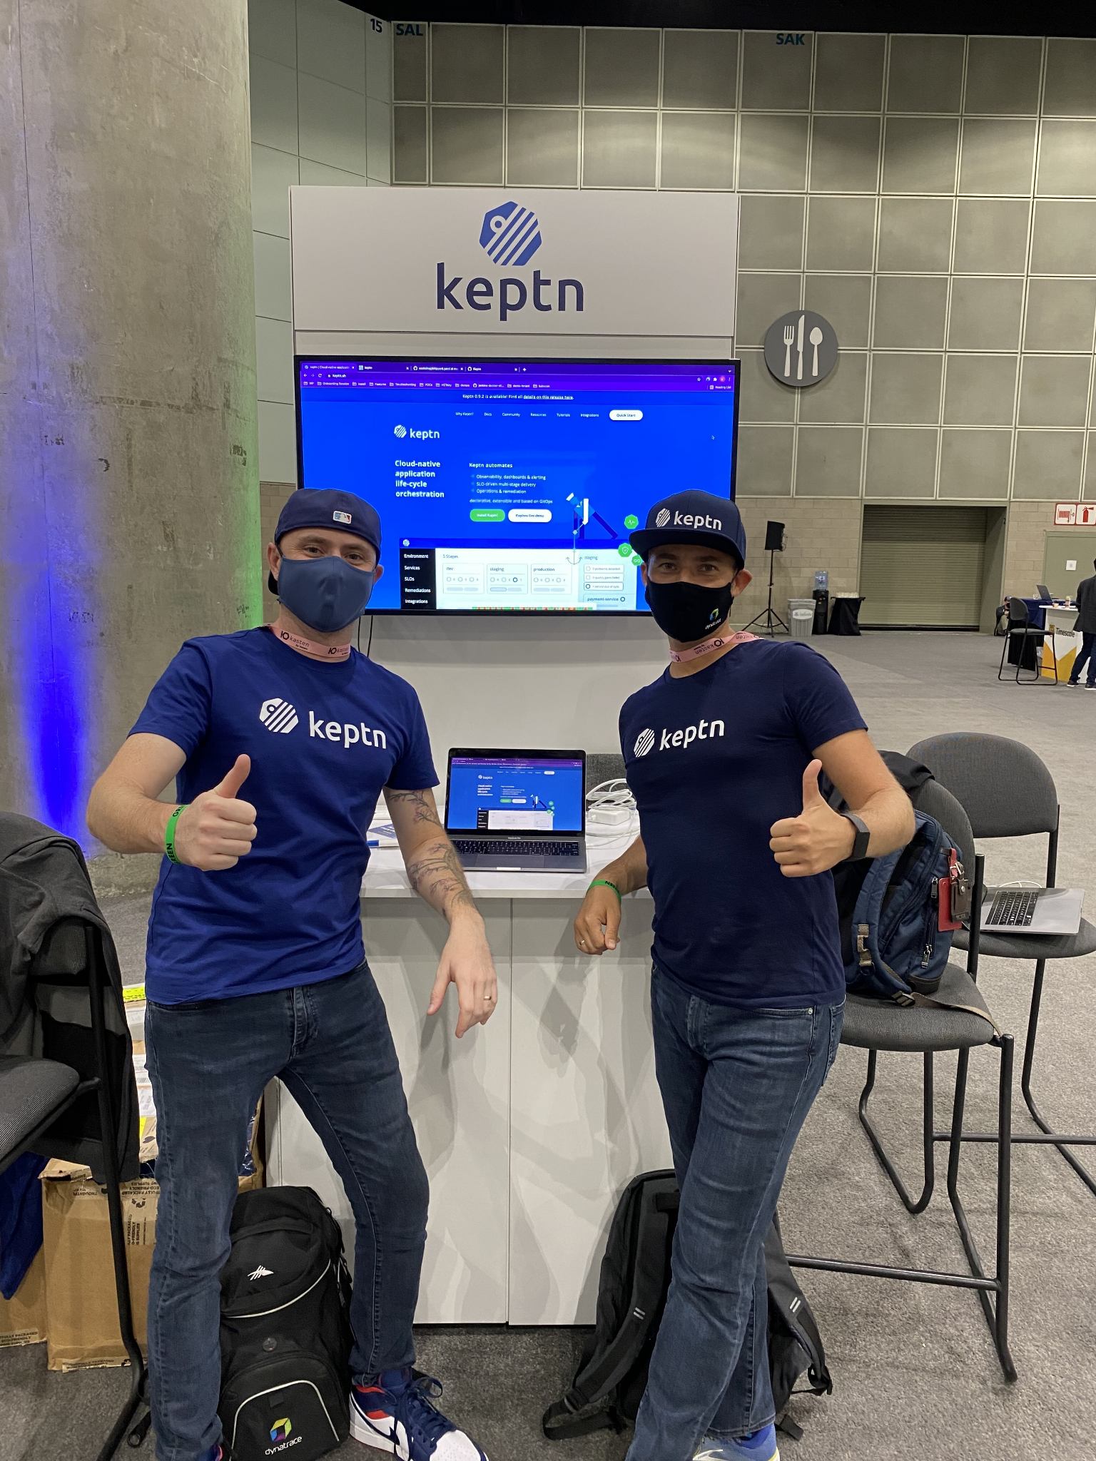
Keptn Kiosk @ Projects Pavilion
Wednesday, May 18: 10:30 - 20:00 CEST
+ Welcome Reception
+ Booth Crawl at 18:00
Thursday, May 19: 10:30 - 17:30 CEST
Friday, May 20: 10:30 - 16:00 CEST

Slide 26



Thank you,
Keptn Obvious!
It is observable
keptn.sh

